Slide 1
Open House
Patrice Ingram 2023

Slide 2
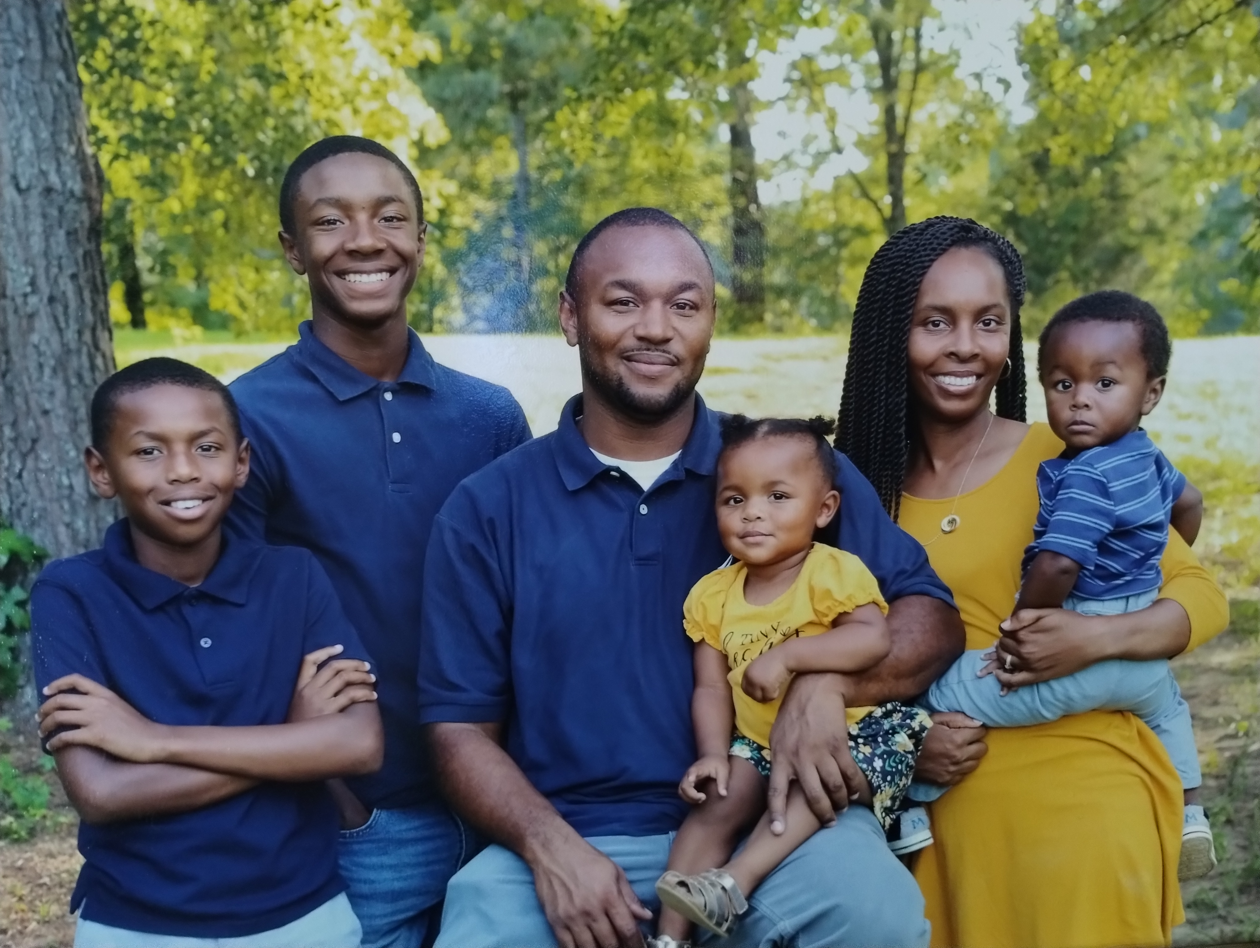
Introduction
Bachelor’s from U of M
Master’s from Arkansas State University
Instructional leadership license from Bethel University
EDS in leadership from Arkansas State
13th year teaching
8th year teaching 2nd grade
Married with three sons, and one daughter

Slide 3
Be ready
Be respectful
Be responsible for your actions
Be honest
Be fair
Try your best
Follow directions the first time given

Slide 4
BEHAVIOR
Dojo Points
Behavior Calendar
T.R.A.C.K. points
S=1-10 TRACK POINTS
N=11-20 TRACK POINTS
U= 21 OR MORE

Slide 5
What’s different about 2nd grade
Starting to read for understanding more and reading on their own more.
Second grade is a transition year for most students because they are expected to be more independent.
Students will be copying things from the board and from their books more.
We may do one or two examples together and students will do the rest independently.

Slide 6
Classwork
Students are given more than enough time to get their classwork done. I try to make sure they get double the time it actually takes to get it done.
We will always practice a skill multiple times before I take a grade on it.
Encourage your child to pay attention and get their work done on time.
If they are absent graded work must be done in class.
Classwork folder

Slide 7
Homework
Homework will be assigned on Monday(phonics), Tuesday(grammar/comprehension), and Thursday(math).
Homework should be returned the next day.
Students should be reading nightly for at least 20 minutes, then add the information to their reading log.
* If a student does not turn in homework they will receive an S-for the day.

Slide 8
Sight Word Tests
Students will be given a list of 100 words each month starting in September. They will be assessed over their monthly list on the first school day of the next month.

Slide 9
H.E.A.R.T Binder
Contents
Papers to be signed and returned (front pocket)
Zipper pouch
Newsletter
Schedule
Monthly Sight Words
Related Arts Calendar
Monthly Behavior Calendar
Homework folder and graded papers folder(on Thursday)
Math and Ela Resource pages (NOT ADDED YET)
Papers to keep at home(back pocket)

Slide 10
Testing
Aim's Web
Common Assessment
Sight word test
Weekly comprehension
Weekly spelling test (starting in a few weeks)
Weekly grammar test ( starting in 2 weeks)
Math Topic test

Slide 11
Other Classroom Info
Graded papers will go home on Thursdays and should be sent back by the next Monday.
Resources that can be accessed through Clever
Espark (Math and Reading)
Prodigy
Epic
Splash learning
Xtra Math( haven't started)

Slide 12
Family Learning Center
They will send extra resources to the school for your child if requested
901-475-5967

Slide 13
Other Info
Easy CBM(Curriculum-Based Measurement) will be our universal screener for RTI purposes.
The school asks that you purchase ice cream from the cafeteria or bring non edible treats for birthday celebrations.

Slide 14
Donations
Treasure Box items
Candy
Masking Tape
Colored Copy Paper
Card stock
Microban

Slide 15
ANY QUESTIONS?????

